Slide 1
Advanced Game Engine Creation
3D Viewing
Lecture 5

Slide 2
Objectives
Last week we:
Discussed how 3D transformations can be represented using matrices
Introduced homogeneous transformation matrices
Applied matrix multiplication to transform objects in 3D space
This week we will:
introduce 3D viewing concepts
orthographic vs perspective view
camera analogy
back face culling

Slide 3
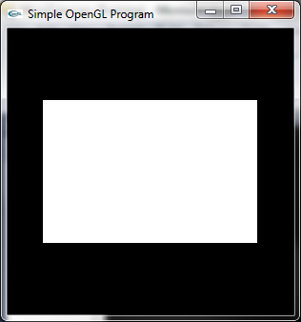
Recall: OpenGL coordinates
y
(1, 1)
(-1, 1)
OpenGL uses right-handed coordinates by default
when defining and viewing a 2D scene
the x-axis increases going to the right
the y-axis increases going up
3D scenes need a z-axis
which increases as you go out of the paper/screen/board towards the viewer
x
(-1, -1)
(1, -1)

Slide 4
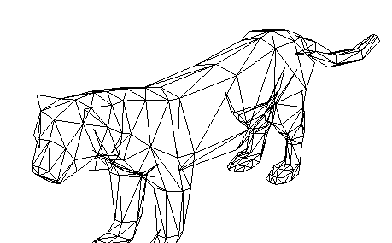
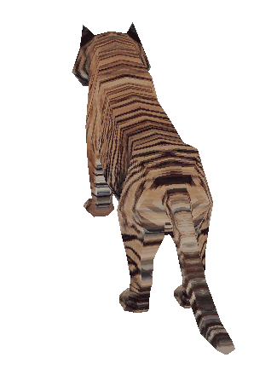
Camera paradigm for 3D viewing
3D viewing is like taking a picture with a camera
2D picture
Camera
2D view of 3D scene will depend on:
camera parameters
where it is
which way it is pointing
field of view
properties of scene objects
illumination
3D scene

Slide 5
Orthographic projection
parallel rays are used to project the scene from 3D to 2D
from our camera position looking down the negative z-axis:
the x- and y- values of the model are preserved
the z-values are set to zero
there is no perspective
the scene looks flat
objects look the same size no matter how far away they are
good for blueprints and architectural drawings

Slide 6
Using a camera with orthographic projection
in a 2D we can pan around the scene by changing the left, right, bottom and top clip coordinates
we could also do this in 3D
now we are specifying clipping planes
we also need to specify the front and back clipping frames
what is the closest point we can see?
front clipping plane
what is the farthest point we can see?
back clipping plane
together, these coordinates specify a view volume
relative to the position of the camera

Slide 7
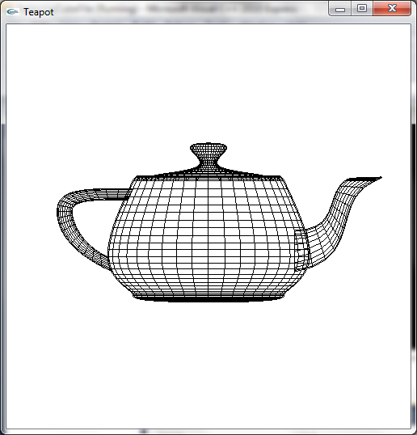
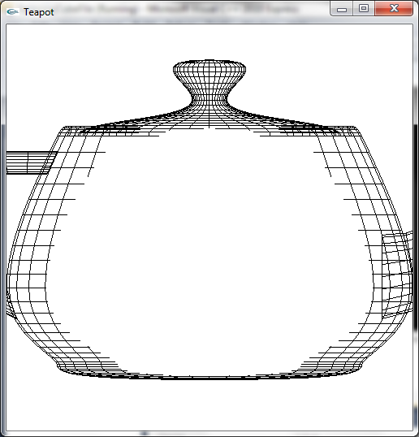
Orthographic projection
same as OpenGL default:
glMatrixMode(GL_PROJECTION);
glLoadIdentity();
glOrtho(-1.0, 1.0, -1.0, 1.0, -1.0, 1.0);
glMatrixMode(GL_PROJECTION);
glLoadIdentity();
glOrtho(-0.5, 0.5, -0.5, 0.5, -0.3, 0.3);

Slide 8
Positioning the camera
in 3D we can position the camera to look at the scene from different viewpoints
in 2D we can only look at it flat on from the front
we need to specify
the position of the camera
which direction it is pointing (what is it looking at?)
which way is up?

Slide 9
Positioning the camera
the OpenGL function to position the camera is gluLookAt()
it has 9 parameters:
the (x,y,z) coordinates of the camera
the (x,y,z) coordinates of a point the camera is looking at
the (x,y,z) direction of the up-vector
which direction is the top of the picture?

Slide 10
Specifying the camera and drawing the teapot
struct point3D {
float x;
float y;
float z;
};
struct camera {
point3D pos;
point3D lookAt;
point3D up;
};
camera cam = {0, 0, 5, 0, 0, 0, 0, 1, 0};

Slide 11
Specifying the camera and drawing the teapot
void GameScreenLevel1::Render(){
glClear(GL_COLOR_BUFFER_BIT | GL_DEPTH_BUFFER_BIT);
glMatrixMode(GL_MODELVIEW);
glColor3f(0.0f, 0.0f, 0.0f);
glLoadIdentity(); // reset the matrix
gluLookAt(cam.pos.x, cam.pos.y, cam.pos.z,
cam.lookAt.x, cam.lookAt.y, cam.lookAt.z,
cam.up.x, cam.up.y, cam.up.z);
glutWireTeapot(1.0);
}

Slide 12
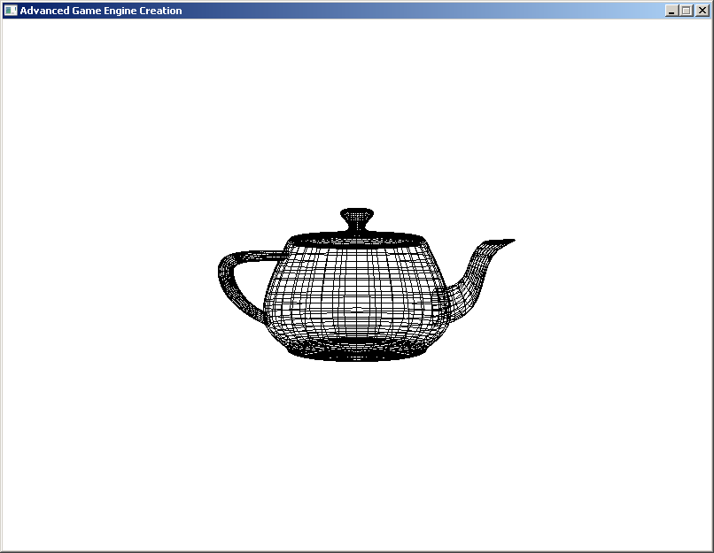

Slide 13
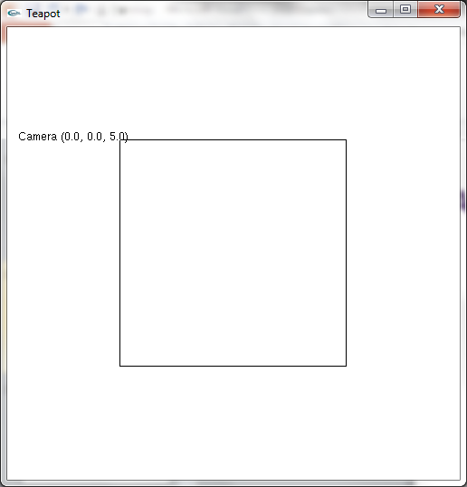
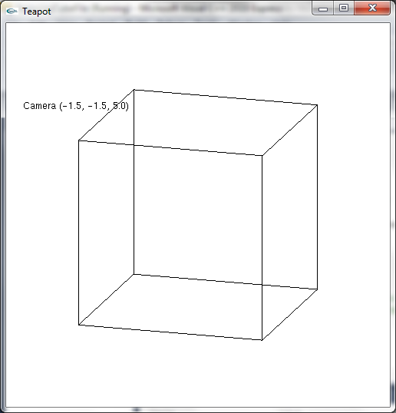
A Wire Cube
remember we are using orthographic projection
no perspective

Slide 14
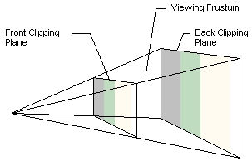
Perspective projection - The view frustum
with perspective projection rays projecting from the 3D scene converge at the camera
objects which are farther away from the camera look smaller
the view volume or frustrum is in the shape of a truncated pyramid
still has a front and back clipping plane
but the side and top/bottom walls are angled

Slide 15
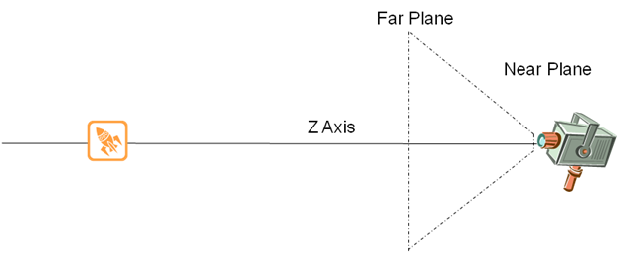
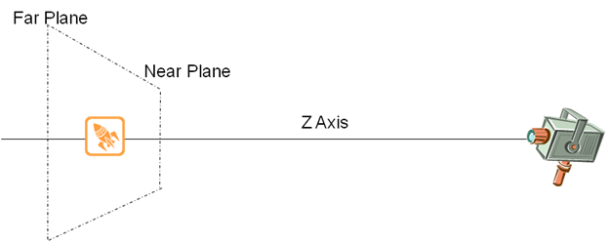
Position of view frustum
only objects within the frustum are visible

Slide 16
Two ways of specifying the frustum in OpenGL
glFrustum() has the same parameters as glOrtho()
left, right, bottom, top, near, far clipping planes
the first four are defined where they intersect the near clipping plane
glFrustum(-1.0, 1.0, -1.0, 1.0, 2.0, 10.0);
gluPerspective() defines
a field-of-view angle in the y-direction
the aspect ratio
and the near and far clipping planes
gluPerspective(45.0, 1, 2.0, 10.0);

Slide 17
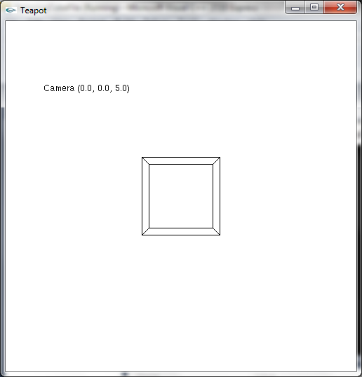
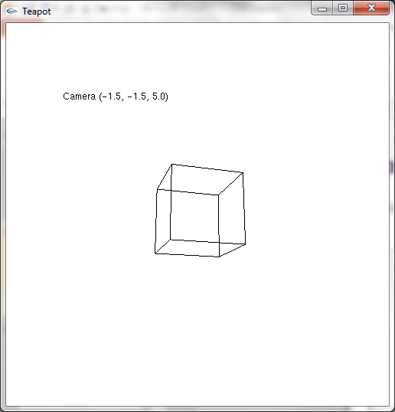
Perspective viewing of a cube
we can see both the front and back faces
the back face is smaller as it is farther away

Slide 18
Perspective viewing of a cube
our cube looks a little strange
hard to tell which side is towards us
viewing a solid cube will help
as we haven’t covered lighting yet, we’ll give each face a different colour

Slide 19
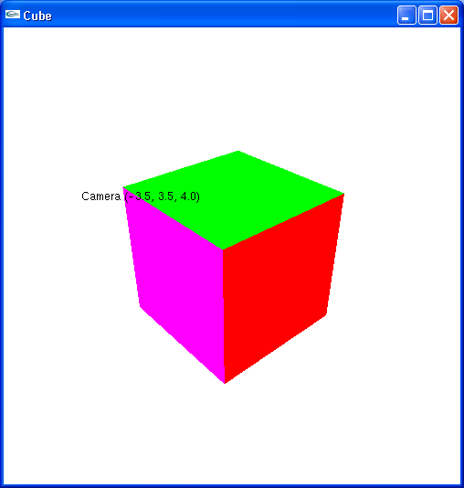
Coloured cube

Slide 20
Data file for a cube
8
-1.0 -1.0 1.0
-1.0 1.0 1.0
1.0 1.0 1.0
1.0 -1.0 1.0
-1.0 -1.0 -1.0
-1.0 1.0 -1.0
1.0 1.0 -1.0
1.0 -1.0 -1.0
6
1.0 0.0 0.0
0.0 1.0 1.0
1.0 1.0 0.0
0.0 1.0 0.0
0.0 0.0 1.0
1.0 0.0 1.0
6
0 3 2 1
2 3 7 6
3 0 4 7
1 2 6 5
4 5 6 7
5 4 0 1
the file specifies:
number of vertices (corners)
the coordinates of each vertex
the number of colours
the r, g, b component of each colour
the number of faces
the indices of the four vertices making up each face
notice that we have specified each vertex only once
and used each in 3 different faces

Slide 21
Data structures for a cube
struct point3D {
float x;
float y;
float z;
};
struct colour{
float r;
float g;
float b;
};
struct polygon {
int a;
int b;
int c;
int d;
};
point3D * vertices;
colour * colours;
polygon * indices;

Slide 22
Drawing a cube
void drawPolygon(int a, int b, int c, int d) {
glBegin(GL_QUADS);
glVertex3fv(&vertices[a].x);
glVertex3fv(&vertices[b].x);
glVertex3fv(&vertices[c].x);
glVertex3fv(&vertices[d].x);
glEnd();
}
void drawCube() {
for (int i = 0; i < NUM_POLY; i++){
glColor3f(colours[i].r, colours[i].g, colours[i].b);
drawPolygon(indices[i].a, indices[i].b, indices[i].c, indices[i].d);
}
}

Slide 23
Winding order
the order that we specify the vertices in each face is important
the winding order
the convention in OpenGL is that the vertices of the front face of each polygon are specified in counter-clockwise order (winding)
if we were inside the cube looking out, we would see the back faces of the polygons
make sure all the outside faces of the cube have CCW winding
1
2
0
3

Slide 24
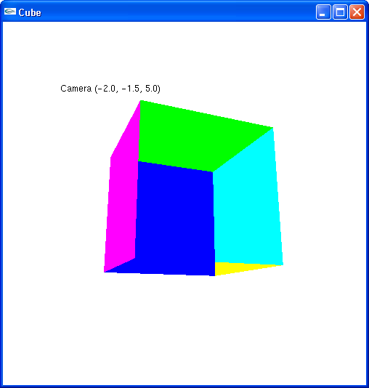
Perspective cube
even though our winding is correct, our cube looks strange
perhaps we should ensure we only draw the polygons facing the camera
back-face culling is the process of not displaying the polygons which face away from the camera
the ones inside the cube

Slide 25
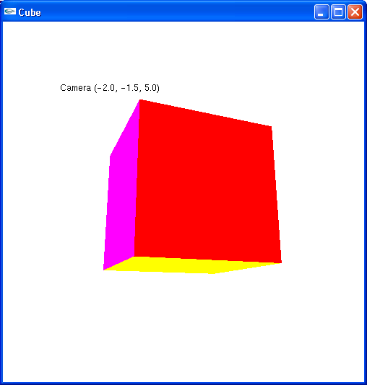
Perspective cube with backface culling
in constructor or a setup method:
enable face culling
specify which face to cull
glEnable(GL_CULL_FACE;
glCullFace(GL_BACK);

Slide 26
Order of drawing
the faces are drawn in the order specified
without backface culling, the front (red) face was drawn first
the other faces were drawn over top
without back-face culling
with back-face culling

Slide 27
Z-buffer
although back-face culling solves the overdraw problem for a single cube, it won’t help in a scene with multiple objects
where some are behind others
want to make sure that the frontmost objects obscure the objects behind them
solution: use a z-buffer (depth buffer)
when a polygon is rendered, the distance from the camera (z-coordinate) for each pixel is kept in a z-buffer
as well as the colour for each pixel in the frame buffer
a colour is not placed in the frame buffer if its z-depth is greater than the current entry

Slide 28
Depth-testing in OpenGL
in main, specify depth-testing mode before creating the window
glutInitDisplayMode(GLUT_RGB |GLUT_DEPTH);
after the window is created, enable depth testing
glEnable(GL_DEPTH_TEST)
in the drawing function, clear the depth buffer as well as the colour buffer
glClear(GL_COLOR_BUFFER_BIT | GL_DEPTH_BUFFER_BIT);

Slide 29
Depth-testing and back-face culling
Back-face culling improves performance
polygons facing away from the camera are not processed and drawn
z-buffering (depth-testing) improves the output
otherwise objects further from the camera could be drawn over nearer objects
but requires additional
processing time – storing and checking the depths
space - to store the z-buffer
an alternative is the painter’s algorithm
sort objects in order of depth, and render from back to front

Slide 30
Different ways to specify vertices
in our 2D programs, we specified vertex positions using the glVertex2f function:
glVertex2f(xPos, yPos);
parameter – two float representing x and y values
passed by value
in the cube program, we used glVertex3fv
glVertex3fv(&vertices[a].x);
parameter – a pointer/reference to a memory position
find 3 floats (x, y, z values) starting here
pass by reference

Slide 31
glVertex variations
see http://www.opengl.org/sdk/docs/man/ under 'v'
can take 2, 3 or 4 coordinates
(x, y, z, w) 2D, 3D, homogeneous 3D
coordinates can be specified as shorts (s), integers (i), floats (f) or doubles (d)
coordinates can be passed by:
value (default)
or reference (v for vector)
pointer to an array
glVertex2f(xPos, yPos);
glVertex3fv(&vertices[a].x);

Slide 32
glColor variations
similar set of variations
3 or 4 colours (r, g, b, alpha)
byte, short, int, float, double
signed (default) or unsigned (u)
float and double are in the range 0.0 (no intensity) to 1.0 (full intensity)
unsigned byte, short and int are mapped to the range 0.0-1.0
using the lowest and highest possible positive values of this type
unsigned byte 0 (no intensity) to 255 (full intensity)
signed byte, short and int are mapped to the range
-1.0 to 1.0
signed byte 0 (no intensity) to 127 (full intensity)

Slide 33
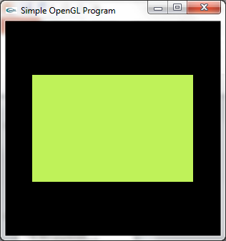
glColor variations
glColor3f(0.75, 0.95, 0.35);
or glColor3ub(191, 242, 89);
or glColor3b(96, 121, 45);
or float col[] = {0.75, 0.95, 0.35};
glColor3fv(col);
or (in the cube program)
glColor3fv(&colours[i].r);

Slide 34
Summary
This lecture we have
introduced 3D viewing in OpenGL
discussed orthographic and perspective projection
further discussed 3D viewing using a solid cube with different coloured faces
Tutorial exercise
implement the coloured cube!
modify it to render triangles rather than quads
Reading:
OpenGL programming Guide – Chapter 3 Viewing
http://glprogramming.com/red/chapter03.html
OpenGL 2.1 API documentation
http://www.opengl.org/sdk/docs/man/
GLUT API documentation http://www.opengl.org/resources/libraries/glut/spec3/spec3.html
Chapter 11 – Geometric Object Rendering

